Slide 1

Sinhgad College of Engineering, Pune – 41.
Department of Electronics &Telecommunication Engineering
“ IoT Based Crop Monitoring System”
By
NAME- 1) VINAYAK BANSODE (404A012)
2) ADITI TARALEKAR (404C074)
3) SANKET ROKADE (404C060)
Under the Guidance-
Prof. Dr. (Mrs.) A.M. Deshmukh.
07/11/2022
Sinhgad College of Engineering, Pune – 41.
Department of Electronics &Telecommunication Engineering

Slide 2
CONTENTS
Introduction
Problem Statement
Objective
Literature Survey
Block Diagram
Advantages
Applications
Selection Criterion of Components
Conclusion
References
07/11/2022
Sinhgad College of Engineering, Pune – 41.
Department of Electronics &Telecommunication Engineering

Slide 3
Introduction
Agriculture is the main source of income for most people in India and contributes significantly to the Indian economy. It could be very vital to do it efficiently agricultural interventions and the answer is IoT to combine with the Wi-Fi sensor network. Internet of Things (IoT).it's far a manner of connecting the entirety of the internet - connecting an item or objects (inclusive of a car, home, digital Devices, etc. ...) formerly unrelated to the principle motive of IoT to make sure the shipping of rights statistics to the proper humans on the proper time.
The project utilizes IoT technology in agriculture, collecting information to help farmers identify problems on time.
07/11/2022
Sinhgad College of Engineering, Pune – 41.
Department of Electronics &Telecommunication Engineering

Slide 4
Problem Statement
Develop a system for predicting potential pesticides, best environment for crops.
With help of Remote sensing Technologies develop crop protection solution from different environment issue.
07/11/2022
Sinhgad College of Engineering, Pune – 41.
Department of Electronics &Telecommunication Engineering

Slide 5
Objective
In IOT enabled weather monitoring system project, Arduino Uno measures 3 weather parameters using respective 3 sensors. These sensors are temperature sensor, humidity sensor and rain level sensor.
These 3 sensors are directly connected to Arduino Uno since it has an inbuilt Analog to digital converter. Arduino calculates and displays these weather parameters on an LCD display.
It sends these parameters to the Internet using IOT techniques. The process of sending data to the internet using Wi-Fi is repeated after constant time intervals. Then the user needs to visit a particular website to view this data.
The project connects and stores the data on a web server. Thus the user gets Live reporting of weather conditions which are suitable for your crop. Internet connectivity or Internet connection with Wi-Fi In IOT enabled crop monitoring system project, Arduino Uno measures is compulsory in this IOT crop monitoring project.
07/11/2022
Sinhgad College of Engineering, Pune – 41.
Department of Electronics &Telecommunication Engineering

Slide 6
Literature Survey
Sr. No | Authors | Proposed Method | Advantages | Disadvantages
1. | Alfiya Abubaker, Kavya, Tilju Thomas3, Nikhil Joseph4, Shifana Begum, | There are possible to make the user-friendly live weather monitoring system using IoT technology. IoT is an Internet of things which capable of transferring data over a network without requiring human interaction | Useful for the agriculture sector as a system is very cheaper. it can be affordable to Farmer. By making an extensive network of this device, we can fetch real-time data of weather from a different location that can be available for free help purpose. | Weather radar has the limitation of not being able to detect fog. This creates a gap in weather forecasting where an area that is likely to receive fog is not properly profiled
2. | Mourvika Shirode, Monika Adaling, Jyoti Biradar, Trupti Mate | Monitoring the weather parameter is required to assess the live condition of the weather that takes the right life action according to fetched data from the device. | With the development of a cloud-based system, the cloud platform can give better weather availability of data anywhere and anytime. | Weather radar has the limitation of not being able to detect fog. This creates a gap in weather forecasting where an area that is likely to receive fog is not properly profiled
Sinhgad College of Engineering, Pune – 41.
Department of Electronics &Telecommunication Engineering

Slide 7
Literature Survey
Sr. No | Authors | Proposed Method | Advantages | Disadvantages
3. | K. N. V. Satyanarayana, S. R. N. Reddy, K. N. V. Suresh Varma & P. Kanaka Raju | It is an embedded system which consists of web enabled smart such as processors, sensors and communication hardware, to fetch, transmit and work on available data they obtained from their weather. The IoT devices sends this processed data to the network gateway, and from there, it will be available to within network. | by designing such a system which also available on public Internet also is make more advantage to human life. | We all know that a weather station is not a single device, but it is a combination of many small tools to form a larger system. It contains various sensors and gadgets that work together but in specific ways to transmit proper and accurate data of the weather parameter
4. | Karthik Krishnamurthi, Suraj Thapa, Lokesh Kothari, Arun Prakash | Here the author have designed our cloud-based server because of that anyone can easily access our web-based service or through android app | Previously many of IoT based weather monitoring system design used third parties IoT platform such as Thing Speak was looked ahead. | The main disadvantage of an automatic weather station is that it removes the observer from the real elements being measured, and so the experience of what -5ºC temperatures or 30 knot winds feel like, is lost.
Sinhgad College of Engineering, Pune – 41.
Department of Electronics &Telecommunication Engineering

Slide 8
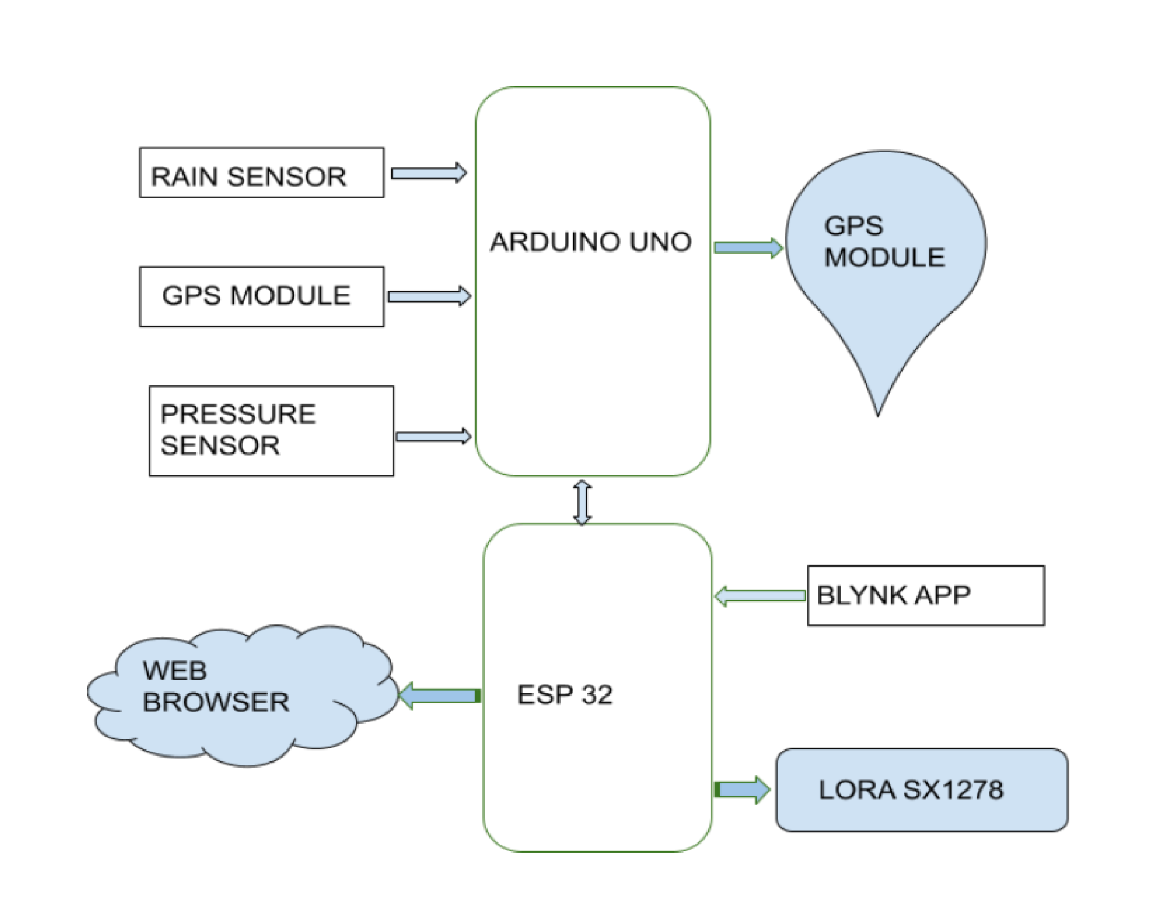
Block Diagram
07/11/2022
Sinhgad College of Engineering, Pune – 41.
Department of Electronics &Telecommunication Engineering

Slide 9
Advantages
Data are available on the Web Browser.
Prior weather alert or weather data can be possible.
Useful for the agriculture sector as a system is very cheaper.
It can be affordable to Farmer.
By making an extensive network of this device, we can fetch real time data of weather from a different location that can be available for free help purpose.
07/11/2022
Sinhgad College of Engineering, Pune – 41.
Department of Electronics &Telecommunication Engineering

Slide 10
Applications
We all know that a weather station is not a single device, but it is a combination of many small tools to form a larger system. It contains various sensors and gadgets that work together but in specific ways to transmit proper and accurate data of the weather parameter
The aim of weather monitoring system is to detect, record and display various weather parameters such as temperature, humidity , pressure
This system makes use of sensors for detecting and monitoring weather parameters and then this collected information is sent to the cloud which can be accessed using the internet.
07/11/2022
Sinhgad College of Engineering, Pune – 41.
Department of Electronics &Telecommunication Engineering

Slide 11
Selection criterion of components
ESP32 Board
Operating Voltage | 2.2V to 3.6V
GIPO | 36 ports
ADC | 14 ports
DAC | 2 ports
Flash Memory | 16 Mbytes
SRAM | 250 Kbytes
Clock Speed | Up to 240 MHz
Wi-Fi | 2.4 GHz
Sleep Current | 2.5 µA
07/11/2022
Sinhgad College of Engineering, Pune – 41.
Department of Electronics &Telecommunication Engineering

Slide 12
Selection criterion of components
Arduino Pro Mini
Microcontroller | ATmega328P
Board Power Supply | 3.35 -12 V (3.3V model) or 5 - 12 V (5V model)
Circuit Operating Voltage | 3.3V or 5V (depending on model)
Digital I/O Pins | 14
PWM Pins | 6
UART | 1
SPI | 1
I2C | 1
Analog Input Pins | 6
External Interrupts | 2
DC Current per I/O Pin | 40 mA
Flash Memory | 16 KB
SRAM | 1 KB
EEPROM | 512 bytes
Clock Speed | 8 MHz (3.3V versions) or 16 MHz (5V versions)
07/11/2022
Sinhgad College of Engineering, Pune – 41.
Department of Electronics &Telecommunication Engineering

Slide 13
Selection criterion of components
GPS
Receiver Type | Multichannel (12-CH, SBAS 1-CH) all-in-view
Frequency | 1575.42MHz ± 1MHz (C/A code)
Sensitivity | -135dBm for acquisition, -138dBm for tracking
Accuracy | 30m 2DRMS (C/A code, HDOP<=4, SA OFF) 7m 2DRMS when SBAS corrected
Time to first fix | Typically, 40 sec (cold start fix) Typically, 33 sec (warm start fix)
Position update | Normally every 1 sec
07/11/2022
Sinhgad College of Engineering, Pune – 41.
Department of Electronics &Telecommunication Engineering

Slide 14
Selection criterion of components
Rain Sensor
Operating voltage | 3.3 to 5V
operating current | 15 mA
sensing pad size | 5cm x 4 cm with a nickel plate on one face
Comparator chip | LM393
Output types | AO (Analog o/p voltage) & DO (Digital switching voltage)
The length & width of PCB module | 3.2cm x 1.4cm
07/11/2022
Sinhgad College of Engineering, Pune – 41.
Department of Electronics &Telecommunication Engineering

Slide 15
Selection criterion of components
Barometric Pressure Sensor
Temperature | -40°C to 85°C
Humidity | 0 to 100% RH
Pressure | 300hPa to 1100hPa
Altitude | 0 to 30000ft
07/11/2022
Sinhgad College of Engineering, Pune – 41.
Department of Electronics &Telecommunication Engineering

Slide 16
Selection criterion of components
LoRa Module
Frequency Range | 433MHz
Supply voltage | 1.8~3.6V
Standby current | 1uA
Modulation | FSK/GFSK/MSK/LoRa
Output Power | +20dBm
Sensitivity | -136dBm
Data Rate | <300 kbps
Working Temperature | -40°C ~+80°C
07/11/2022
Sinhgad College of Engineering, Pune – 41.
Department of Electronics &Telecommunication Engineering

Slide 17
Comparison between Rain Sensors
ESP32 And Arduino Uno
Specifications | ESP32 | Arduino Uno
Architecture | 32 Bit | 8 Bit
WIFI | YES | NO
Bluetooth | YES | NO
Flash | 16MB | 32KB
DAC | 2 | 0
ADC | 18 | 6
07/11/2022
Sinhgad College of Engineering, Pune – 41.
Department of Electronics &Telecommunication Engineering

Slide 18
Comparison between Pressure Sensors
BME280 And BME180
Parameters | BME280 | BME180
Dimension | 3.6x3.8mm | 2.0x2.8mm
Minimum Power Supply | 1.80 B | 1.71 B
Power Consumption | 12µA | 2.7µA
Temperature Revolution | 0.1°C | 0.01°C
Pressure Revolution | 1Pa | 0.16 Pa
Measurement Speed | Above 120 Hz | Above 180 Hz
07/11/2022
Sinhgad College of Engineering, Pune – 41.
Department of Electronics &Telecommunication Engineering

Slide 19
Comparison between Temperature Sensors
DHT22 And DHT11
Things to consider | DHT22 | DHT11
Temperature Range | -40 to 80℃ | -20 to 60℃
Temperature Accuracy | ±0.5% | ±2%
Humidity Range | 0 to 100%RH | 5 to 95% RH
Humidity Accuracy | ±2% | ±5%
07/11/2022
Sinhgad College of Engineering, Pune – 41.
Department of Electronics &Telecommunication Engineering

Slide 20
Comparison between GPS modules
Grove GPS Module And NEO-6m
Things to consider | NEO-6M | Grove – GPS Module
Size | 23mm x 30mm | 40mm x 20mm x 13mm
Update Rate | 1Hz, max 5Hz | 1Hz, max 10Hz
Baud Rate | Default 9,600, max 230400 | 9,600 – 115,200
Navigation Sensitivity | -161dBm | -160dBm
Power Requirements | 3V – 5V | 3.3/5V
Number of Channels | 22 tracking, 50 channels | 22 tracking, 66 channels
Antennas | External patch antenna | Antenna included
Accuracy | 2.5m GPS Horizontal Position Accuracy | 2.5m GPS Horizontal Position Accuracy
Time to first start | Cold start: 27s Warm start: 27s Hot start: 1s | Cold start: 13s Warm start: 1-2s Hot start: <1s
07/11/2022
Sinhgad College of Engineering, Pune – 41.
Department of Electronics &Telecommunication Engineering

Slide 21
Conclusions
The data can be visible from anywhere in the world.
By checking and monitoring the vital weather parameters, Crops can be protected from emergency incidents by taking immediate actions to it.
Surveillance at the particular region can be achieved.
07/11/2022
Sinhgad College of Engineering, Pune – 41.
Department of Electronics &Telecommunication Engineering

Slide 22
References
R. Fernandes, R. Oliveira, M. Luis, and S. Sargento, ‘‘On the real capacity of LoRa networks: The impact of non-destructive communications,’’ IEEE Commun. Lett., vol. 23, no. 12, pp. 2437–2441, Dec. 2019.
A. Boano, M. Zuniga, J. Brown, U. Roedig, C. Keppitiyagama, and K. Romer, ‘‘TempLab: A testbed infrastructure to study the impact of temperature on wireless sensor networks,’’ in Proc. IPSN14 Proc. 13th Int. Symp. Inf. Process. Sensor Netw., Apr. 2014, pp. 95–106.
J. Luomala and I. Hakala, ‘‘Effects of temperature and humidity on radio signal strength in outdoor wireless sensor networks,’’ in Proc. Federated Conf. Comput. Sci. Inf. Syst., Oct. 2015, pp. 1247–1255.
A. F. Rachmani and F. Y. Zulkifli, “Design of IoT monitoring system based on LoRa technology for starfruit plantation,” in TENCON 2018 - 2018 IEEE Region 10 Conference, pp. 1241– 1245, Jeju, Korea (South), 2018.
J. Wang, S. Yi, D. Zhan, and W. Zhang, “Design and implementation of small monitoring wireless network system based on LoRa,” in 2019 IEEE 4th Advanced Information Technology, Electronic and Automation Control Conference (IAEAC),, pp. 296–299, Chengdu, China, 2019.
07/11/2022
Sinhgad College of Engineering, Pune – 41.
Department of Electronics &Telecommunication Engineering

Slide 23
Thank You !!
07/11/2022
Sinhgad College of Engineering, Pune – 41.
Department of Electronics &Telecommunication Engineering

